Slide 1
Active learning
张涛、赵春阳、王继欣、阳文灿、王伟成
2018/5/2

Slide 2
Outline
Active Learning Introduction
Query Strategy Frameworks
Theoretical Guarantees
Advanced Methods
Related machine learning algorithms

Slide 3
Active Learning Introduction
张涛 51174500159

Slide 4
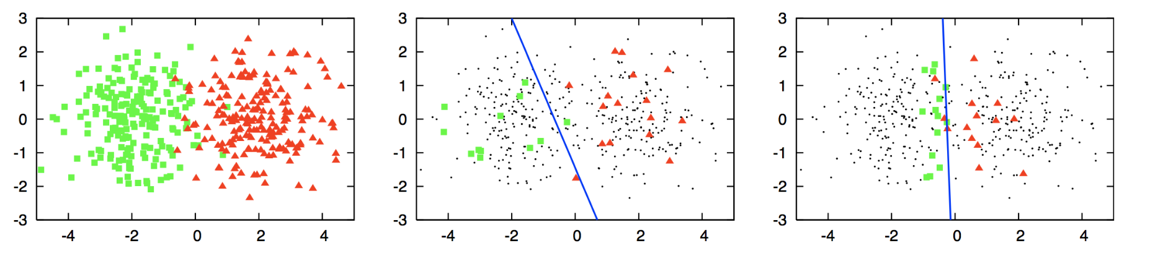
Motivation
Notes:
找一个分界线将这两种颜色的数据给分开（这是一个分类工作，你需要创建一个分类边界）
然而，你可以假设你不知道这些数据的标签，但是尝试获取每一个数据的标签代价非常高。
所以你想去对少量数据加标签，并用它们当做训练集，去得到一个分类器。
中间的逻辑回归被用于分类，首先随机的选取了一些样本数据（并将它们打标签），然而
使用逻辑回归得到的分界线并不是最优的，因为它很明显地倾向于绿色的样本数据，则会有绿色的数据被误认为红色的类别。这个的原因就是选择用于贴标签的数据质量不好。
最右边的图片再次使用逻辑回归，但这次利用主动学习的方法对少量数据贴标签，且找到的分界线明显比中间的要好，这个提升源自于选择了较好的用于贴标签的数据，从而分类器能够用来创建一个更好的决策边界。
所以如何选择好的样本点是主动学习的重点之一。

Slide 5
Supervised Passive Learning
Data Source
Expert / Oracle
Learning Algorithm
Unlabeled examples
Labeled examples
Algorithm outputs a classifier
Notes:
Passive Learing:These are tasks which involve gathering a large amount of data randomly sampled from the underlying distribution and using this large dataset to train a model that can perform some sort of prediction. You will call this typical method passive learning.
被动学习：这些任务从数据的底层分布中随机抽取大量的数据作为样本，来训练可执行某种预测的模型

Slide 6
Incorporating Unlabeled Data in the process
In many settings, unlabeled data is cheap & easy to obtain, labeled data is much more expensive.
Web page, document classification
OCR, Image classification
Notes:
被动学习中最耗时的任务之一就是收集标签数据。
比如拿诊断胰腺癌病人为例，不可能对所有病人进行检查，只能对少量病人进行抽样检查，
相比于随机检查，我们能够基于一些标准选择病人，比如标准可能为病人是否喝酒以及在40岁以上，这个标准并不是一成不变的，可以随着实验的进行发生改变。
例如，如果您意识到你的模型能够很好地预测50岁以上的胰腺癌患者，但却很难为40-50岁的患者做出准确的预测，这可能是您的新标准。
根据我们迄今为止收集的数据选择合适的患者(通用的说为实例)的过程称为主动学习。

Slide 7
Semi-Supervised Passive Learning
Data Source
Learning Algorithm
Expert / Oracle
Unlabeled examples
Unlabeled examples
Labeled Examples
Algorithm outputs a classifier

Slide 8
Semi-Supervised Passive Learning
Several methods have been developed to try to use unlabeled data to improve performance, e.g.:
Transductive SVM [Joachims ’98]
Co-training [Blum & Mitchell ’98], [BBY04]
Graph-based methods [Blum & Chawla01], [ZGL03]

Slide 9
Active Learning
Data Source
Learning Algorithm
Unlabeled examples
Expert / Oracle
Request for the Label of an Example
A Label for that Example
Request for the Label of an Example
A Label for that Example
. . .
Algorithm outputs a classifier
Notes:
先使用有标记的样本数据集训练出一个学习器，再基于该学习器对未标记的样本进行预测，
从中挑选出不确定性高或分类置信度低的样本来咨询专家并进行打标，最后使用扩充后的训练集重新训练学习器，
这样便能大幅度降低标记成本，这就是主动学习。
主动学习的目标是：使用尽量少的/有价值的咨询来获得更好的性能。

Slide 10
What Makes a Good Algorithm?
Guaranteed to output a relatively good classifier for most learning problems.
Doesn’t make too many label requests.
Choose the label requests carefully, to get informative labels.
Notes:
不需要太多的请求贴标签操作就能够为大多数学习问题产生一个较好的分类器。

Slide 11
Can It Really Do Better Than Passive?
YES! (sometimes)
We often need far fewer labels for active learning than for passive.
This is predicted by theory and has been observed in practice.
Notes:
相比于被动学习，我们的主动学习算法需要更少的标签。
这是由理论预测的且在实践中被观察到的。

Slide 12
Scenarios
Membership Query Synthesis
Stream-Based Selective Sampling
Pool-Based sampling
Notes:
主动学习中，通常有三种场景，学习者在不同的场景中查询实例的标签，

Slide 13
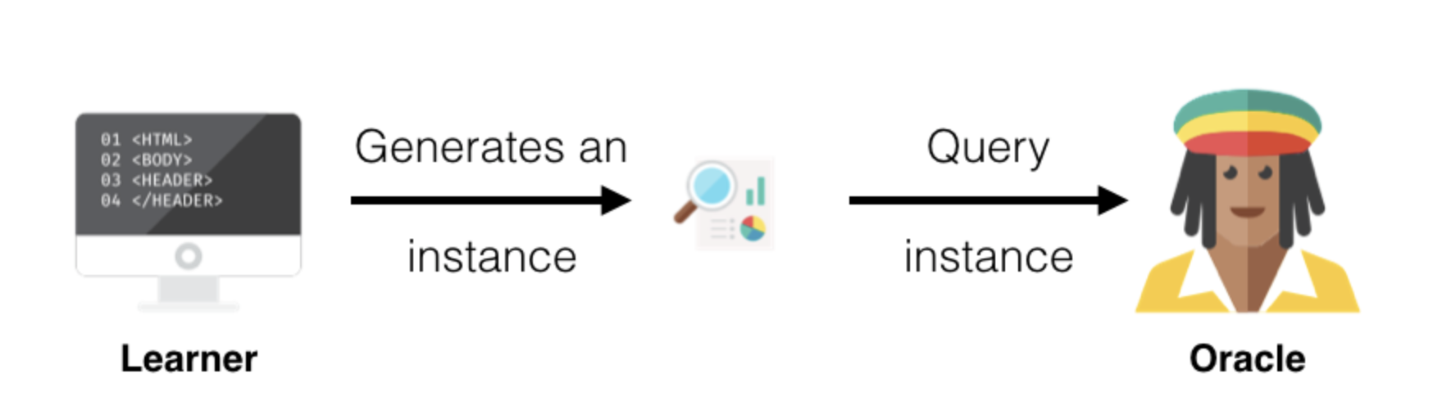
Membership Query Synthesis
Notes:
成员查询合成是一个很大的术语，它仅仅意味着学习者从一些基本的自然分布生成/构造一个实例。
例如，如果数据是数字图片，则学习者将创建一个与数字相似的图像（可能会旋转数字或排除一些数字），并将创建的图像发送给专家去打标签。

Slide 14
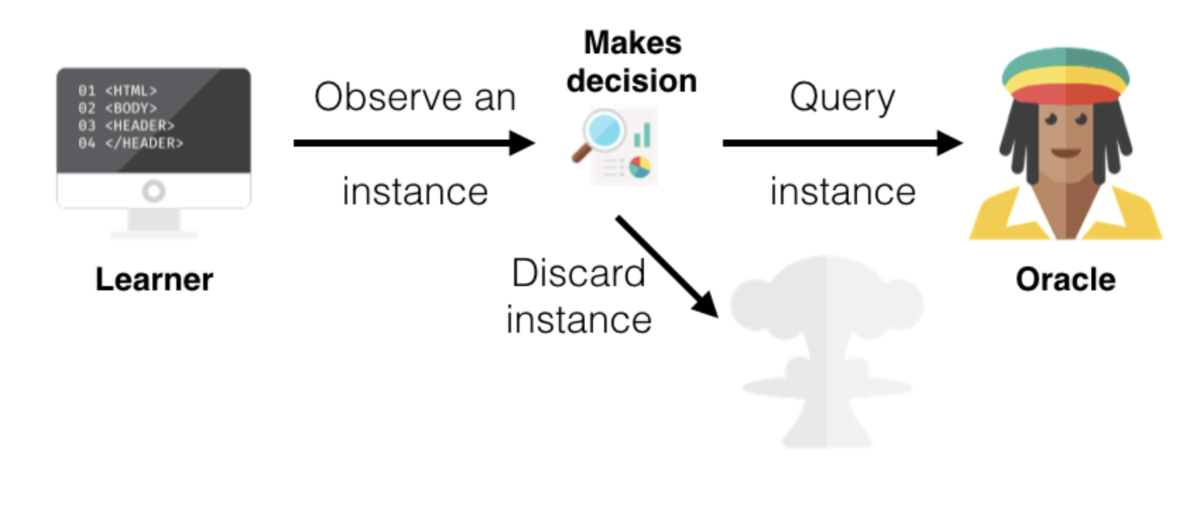
Stream-Based Selective Sampling
Notes:
基于流的选择性采样：假设获取未标的的实例是免费的，基于这个假设，随后一次选择一个未标记的实例，并允许学习者确定是要查询实例的标签还是丢弃它。为了确定实例的信息量，可以使用查询策略(下一节会讲）在上一个例子中，将从未标记的图像集中选择一个图像，确定是否需要标记或者丢弃图像，然后重复下一个图像。

Slide 15
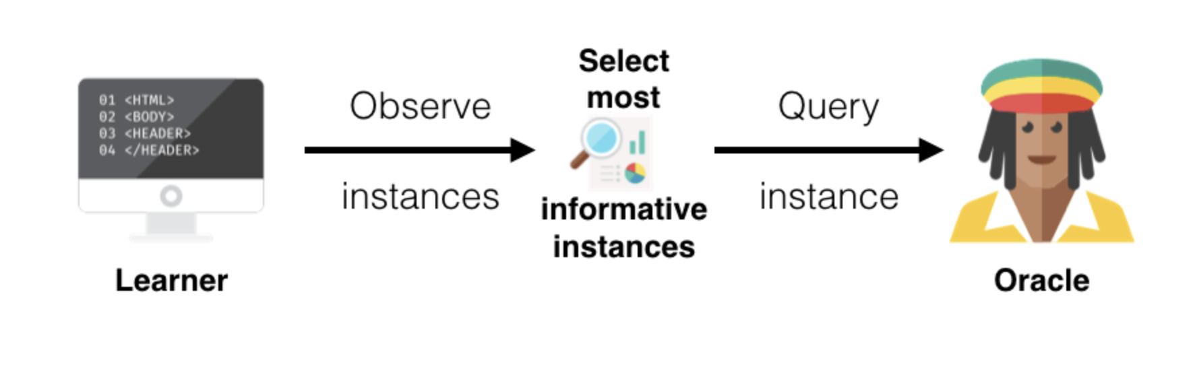
Pool-Based sampling
Notes:
基于池的采样：假定存在大量未标记的数据，与基于数据流的选择性采样一样，然后根据一些信息量从池中抽取实例，此度量适用于池中的的所有实例(如果池非常大，则选一些子集)，然后选择最具有信息价值的实例。
这是主动学习中最常见的情景。
继续拿上述两个例子举例：将对所有未标记的数字图像进行排序，然后选择最好(最具有信息价值)的实例并对它们打标签。

Slide 16
Query Strategy Frameworks
赵春扬 51174500164
Notes:
主动学习中的一个关键问题是如何选择合适的查询策略以最大化分类过程的准确度。通常情况下我们查询的实例具有的特点是
（1）类标签不明确
（2）或者不同的learner在该实例标签的判断上存在差别
但是一些类标签不确定性较高的实例可能是不具有代表性的异常值，这种情况尤其可能发生在非常嘈杂的数据集中。
为了解决这些问题，一些模型直接关注误差本身，又或者试图找到能够代表底层数据的样本。因此我们可以将查询策略分为以下三种类型：
1.The key question in active learning algorithms is to design the precise strategies that are used for querying. At any given point, which sample should be selected so as to maximize the accuracy of the classification process?
2.Since the boundary regions are often those in which instances of multiple classes are present, they can be characterized by class label uncertainty or disagreements between different learners.
3. However, this may not always be the case, because instances with greater uncertainty are not representative of the data, and may sometimes lead to the selection of unrepresentative outliers. This situation is especially likely to occur in data sets that are very noisy. In order to address such issues, some models focus directly on the error itself, or try to find samples that are representative of the underlying data. Therefore, we broadly classify the querying strategies into one of three categories:

Slide 17
Query Strategy Frameworks
关键问题：选择合适的查询策略
Feature
Class label uncertainty
Disagreement between different learners
Outlier
Focus
focus directly on the error itself
try to find samples that are representative of the underlying data
Notes:
主动学习中的一个关键问题是如何选择合适的查询策略以最大化分类过程的准确度。通常情况下我们查询的实例具有的特点是
（1）类标签不明确
（2）或者不同的learner在该实例类别的判断上存在差别
但是一些类别不确定性较高的实例可能是不具有代表性的异常值，这种情况尤其可能发生在非常嘈杂的数据集中。
为了解决这些问题，一些模型直接关注误差本身，又或者试图找到能够代表底层数据的样本。因此我们可以将查询策略分为以下三种类型：
1.The key question in active learning algorithms is to design the precise strategies that are used for querying. At any given point, which sample should be selected so as to maximize the accuracy of the classification process?
2.Since the boundary regions are often those in which instances of multiple classes are present, they can be characterized by class label uncertainty or disagreements between different learners.
3. However, this may not always be the case, because instances with greater uncertainty are not representative of the data, and may sometimes lead to the selection of unrepresentative outliers. This situation is especially likely to occur in data sets that are very noisy. In order to address such issues, some models focus directly on the error itself, or try to find samples that are representative of the underlying data. Therefore, we broadly classify the querying strategies into one of three categories:

Slide 18
categories
Heterogeneity-based models
Uncertainty sampling
Query-by-Committee
Expected Model Change
Performance-based models
Expected Error Reduction
Expected Variance Reduction
Representativeness-based models
Density-Based Models
Notes:
（1）第一类模型是，Heterogeneity-based models（基于异质性的模型）。这类模型的典型策略主要有：uncertainty （an certain tei）sampling, query-by-committee（kang mi te）, 以及 expected model change.这些策略都是从在实例类别不确定的区域或者与目前已经查询过的实例不同的区域进行采样。它们只关注所查询实例的异质性行为，而不是关注选择这个查询实例后，会对将分类剩余未标记实例的分类器性能的所造成影响。
（2）第二类模型是，Performance-based models。这类模型的典型策略主要有：和。这类模型试图通过降低误差或者方差的方法来直接优化分类器的性能。它们的特点是关注选择这个查询实例后，会对将分类剩余未标记实例的分类器性能的影响。与第一类模型刚好相反。
（3）第三类模型是，Representativeness-based models（基于代表性的模型）。这类模型试图创建能尽可能代表底层大量训练实例的数据。典型策略主要有Density（deng sui te）-Based Models。
In these cases, a product of a heterogeneity criterion and a representativeness criterion is used in order to model the desirability of querying aparticular instance. Thus, these methods try to balance the representativeness criteria with the uncertainty properties of the queried instance.（待翻译）
很明显，在主动学习过程中，人们可以使用多种多样的策略，而这些不同的策略有不同的权衡和不同的工作方式。具体选择什么样的策略主要取决于底层应用程序、分析师目标和数据分布。
（1）Heterogeneity-based models: These models attempt to sample from regions of the space that are either more heterogeneous, or dissimilar to what has already been seen so far. Examples of such models include uncertainty sampling, query-by-committee, and expected model change. All these methods are based on sampling either uncertain regions of the data, or those that are dissimilar to what has been queried so far. These models only look at the heterogeneity behavior of the queried instance, rather than the effect of its addition on the performance of a classifier on the remaining unlabeled instances. （2） Performance-based models: These models attempt to directly optimize the performance of the classifier in terms of measures such as error or variance reduction. One characteristic of these methods is that they look at the effect of adding the queried instance on the performance of the classifier on the remaining unlabeled instances. （3） Representativeness-based models: These models attempt to create data that is as representative as possible of the underlying population of training instances. For example, density-based models are an example of such scenarios. In these cases, a product of a heterogeneity criterion and a representativeness criterion is used in order to model the desirability of querying a particular instance. Thus, these methods try to balance the representativeness criteria with the uncertainty properties of the queried instance.
Clearly, there is significant diversity in the strategies that one may use in the active learning process. These different strategies have different tradeoffs and work differently, depending upon the underlying application, analyst goal, and data distribution.

Slide 19
Uncertainty sampling
Query the instances about which it is least certain how
to label.
For binary classification
queries the instance whose posterior probability of being positive is nearest 0.5 .
For problems with three or more class labels
The least confident
Margin sampling
Entropy
Notes:
（1）uncertainty （an certain tei）sampling （不确定性采样）是一种十分简单和常用的查询框架。在不确定性采样中，learner选择查询它最难确定如何标记的实例。
（2）例如，对于只存在两种类别的概率模型，不确定性采样会查询两种类别的概率最接近于0.5的实例
（3）对于存在三种及以上类别的问题，我们可以有以下三种方法。The least confident, Margin （ma jing）sampling, Entropy（en cuo pei）
（1）Perhaps the simplest and most commonly used query framework is uncertainty sampling . In this framework, an active learner queries the instances about which it is least certain how to label .
（2）For example, when using a probabilistic model for binary classification, uncertainty sampling simply queries the instance whose posterior probability of being positive is nearest 0.5 .
For problems with three or more class labels, a more general uncertainty sampling variant might query the instance whose prediction is the least confident:
where y^ = argmaxy Pθ(yjx), or the class label with the highest posterior probability under the model θ.
in this strategy, the learner selects the instance for which it has the least confidence in its most likely label.
the shortcoming of the LC strategy, is that it only takes into consideration the most probable label and disregards the other label probabilities.
However, the criterion for the least confident strategy only considers information about the most probable label. Thus, it effectively “throws away” information about the remaining label distribution . To correct for this, some researchers use a different multi-class uncertainty sampling variant called margin sampling

Slide 20
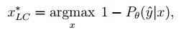
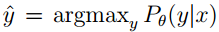
Uncertainty sampling
The least confident
where
In this strategy, the learner selects the instance for which it has the least confidence in its most likely label.
缺点： It only takes into consideration the most probable label and disregards the other label probabilities.
Notes:
（1）首先我们看the least confident，公式如下，在这里y表示在模型θ下实例x具有的最高概率类标签。X*表示最终选择的实例。
（2）由公式可以看出，在这个策略中，learner选择了最高概率类标签最小的实例。
（3）然而the least confident的缺点是，只考虑了最高概率类标签而忽略了其他类标签的概率。因此有了下面一种方法，margin （ma jing）sampling 。
（4）From this point on, I use the notation x∗ A to refer to the most informative instance (i.e., the best query) according to some query selection algorithm A.
（1）Perhaps the simplest and most commonly used query framework is uncertainty sampling . In this framework, an active learner queries the instances about which it is least certain how to label .
（2）For example, when using a probabilistic model for binary classification, uncertainty sampling simply queries the instance whose posterior probability of being positive is nearest 0.5 .
For problems with three or more class labels, a more general uncertainty sampling variant might query the instance whose prediction is the least confident:
where y^ = argmaxy Pθ(yjx), or the class label with the highest posterior probability under the model θ.
in this strategy, the learner selects the instance for which it has the least confidence in its most likely label.
the shortcoming of the LC strategy, is that it only takes into consideration the most probable label and disregards the other label probabilities.
However, the criterion for the least confident strategy only considers information about the most probable label. Thus, it effectively “throws away” information about the remaining label distribution . To correct for this, some researchers use a different multi-class uncertainty sampling variant called margin sampling

Slide 21
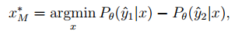
Uncertainty sampling
Margin sampling
selects the instance that has the smallest difference between the first and second most probable labels.
corrects for a shortcoming in the least confident strategy,by incorporating the posterior of the second most likely label.
For problems with very large label sets, the margin approach still ignores much of the output distribution for the remaining classes.
Notes:
（1）边缘采样策略通过选择概率第一高和概率第二高的类标签概率之差最小的实例来克服the least confidence的缺点。
（2）公式如下图，其中y1和y2是模型θ下概率第一高和概率第二高的类标签
（3）边缘采样策略将概率第二高的类标签合并入公式，从而纠正了the least confident 策略的一个缺陷.当实例中概率最大的前两个类标签概率相差较大的时候，分类器可以很容易区分它们；但是当它们相差较小的时候，分类器就难以确定该实例真正的类别了。
（4）然而，当数据类别非常多的时候，该策略依旧会忽略很多剩余类的信息。
（1）The margin sampling strategy seeks to overcome this disadvantage by selecting the instance that has the smallest difference between the first and second most probable labels.
（2）where y^1 and y^2 are the first and second most probable class labels under the model .
（3）Margin sampling aims to correct for a shortcoming in the least confident strategy, by incorporating the posterior of the second most likely label.
（3）Intuitively, instances with large margins are easy, since the classifier has little doubt in differentiating between the two most likely class labels. Instances with small margins are more ambiguous, thus knowing the true label would help the model discriminate more effectively between them.
However, for problems with very large label sets, the margin approach still ignores much of the output distribution for the remaining classes.

Slide 22
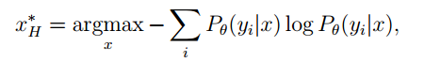
Uncertainty sampling
Entropy（熵）
Entropy is an information-theoretic measure that represents the amount of information needed to “encode” a distribution.
So it is often thought of as a measure of uncertainty or impurity in machine learning measure
The entropy based approach generalizes easily to probabilistic multi-label classifiers and probabilistic models for more complex structured instances
Notes:
（1）还有一种不确定性采样的策略，使用熵（en cuo pei）作为不确定性的一种度量指标。
（2）该策略公式如下，其中yi的范围是所有可能的类标签。
（3）熵（en cuo pei）是信息理论的一种度量指标，经常被认为是机器学习中不确定性的一种衡量标准。
（4）相较于前两张策略，基于熵（en cuo pei）的方法可以很容易推广到处理更多复杂结构实例和更多标签的分类器中。
A more general uncertainty sampling strategy (and possibly the most popular) uses entropy (Shannon, 1948) as an uncertainty measure: where yi ranges over all possible labelings. Entropy is an information-theoretic measure that represents the amount of information needed to “encode” a distribution. As such, it is often thought of as a measure of uncertainty or impurity in machine learning. the entropy based approach generalizes easily to probabilistic multi-label classifiers and probabilistic models for more complex structured instances

Slide 23
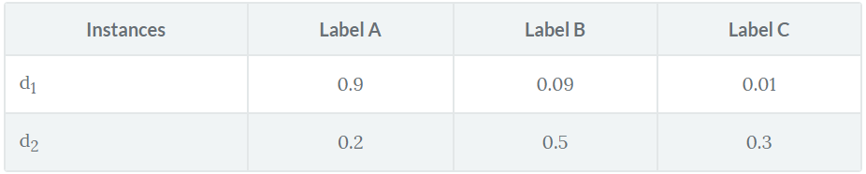
Examples
Least Confidence : 0.9<0.5
Margin Sampling: 0.81 (0.9 - 0.09) <0.2 (0.5 - 0.3)
Entropy Sampling: 0.155<0.447
Notes:
（1）现在我们看一个例子。下表显示了两个数据实例d1,d2，以及它们拥有每个类标签的概率。可以看到，d1有标签A,B,C的概率分别为0.9,0.09和0.01，d2有标签A,B,C的概率分别为0.2,0.5和0.3
（2）在the least confidence策略中，learner选择learner选择了最高概率类标签最小的实例。在这个表中，d1的最高概率类标签为A，概率为0.9. d2的最高概率类标签为B，概率为0.5.所以最终learner选择查询d2的真实标签。
（3）在Margin(ma jing） Sampling策略中，learner选择概率第一高和概率第二高的类标签概率之差最小的实例。d1为0.81 (0.9 - 0.09) ，d2为 0.2 (0.5 - 0.3)。所以最终learner选择查询d2的真实标签。
（4）在Margin (ma jing） Sampling策略中，learner利用了所有可能的标签的概率，对每个实例都使用了熵的公式，其中熵值最大的实例就是要查询的实例。在上表中，d1的熵值为0.155，d2的熵值为0.447.所以最终learner选择查询d2的真实标签
Least Confidence (LC): in this strategy, the learner selects the instance for which it has the least confidence in its most likely label. Looking at the table, the leaner is pretty confident about the label for d₁, since it thinks it should be labelled A with probability 0.9, however, it is less sure about the label of d₂ since its probabilities are more spread and it thinks that it should be labelled B with a probability of only 0.5. Thus, using least confidence, the learner would select d₂to query it's actual label.
Margin Sampling: the shortcoming of the LC strategy, is that it only takes into consideration the most probable label and disregards the other label probabilities. The margin sampling strategy seeks to overcome this disadvantage by selecting the instance that has the smallest difference between the first and second most probable labels. Looking at d₁, the difference between its first and second most probable labels is 0.81 (0.9 - 0.09) and for d₂ it is 0.2 (0.5 - 0.3). Hence, the leaner will select d₂ again.
Entropy Sampling: in order to utilize all the possible label probabilities, you use a popular measure called entropy. The entropy formula is applied to each instance and the instance with the largest value is queried. Using our example, d₁ has a value of 0.155 while d₂'s value is 0.447 and so the learner will select d₂ once again.

Slide 24
Query-by-Committee
Idea
a variety of models are trained on the current labeled data, and vote on the output for unlabeled data; label those points for which the "committee" disagrees the most.
The QBC approach involves maintaining a committee of models which are all trained on the current labeled set.
Each committee member is then allowed to vote on the labelings of query candidates. The most informative query is considered to be the instance about which they most disagree .
implement a QBC selection algorithm:
be able to construct a committee of models that represent different regions of the version space
have some measure of disagreement among committee members.
Notes:
（1）现在我们看一下基于异质性的模型的 另一种查询策略Query-by-Committee（kang mi tei）。该策略主要思想是在当前已经标记的数据集上训练多种模型，通过得到的结果对未标记数据进行投票，选择各模型结果意见最不统一的实例。
（2）该策略需要维护一个委员会，委员会成员为需要在已经标记数据集上进行训练的模型，这些模型的训练结果通常并不相同。每个委员会成员都需要对待查询的数据进行投票，最终选出意见最不统一的实例。
（3）因此，为了能够保证该策略的运行，至少需要保证以下两点：
（4）一是能够构建不同模型组成的委员会，二是能够对委员会成员的意见不统一程度有一个度量标准。
（1）a variety of models are trained on the current labeled data, and vote on the output for unlabeled data; label those points for which the "committee" disagrees the most.
（2）The QBC approach involves maintaining a committee C = fθ(1); : : : ; θ(C)g of models which are all trained on the current labeled set L, but represent competing hypotheses. Each committee member is then allowed to vote on the labelings of query candidates. The most informative query is considered to be the instance about which they most disagree （3）In order to implement a QBC selection algorithm, one must: i. be able to construct a committee of models that represent different regions of the version space, and ii. have some measure of disagreement among committee members.

Slide 25
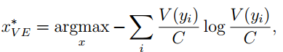
Query-by-Committee
The measure of the level of disagreement
Vote entropy
y_{i} ranges over all possible labelings.
V(y_{i}) is the number of “votes” that a label receives from among the committee members’ predictions.
C is the committee size.
Notes:
（1）为了度量意见不统一的程度，这里先讲一种方法是vote entropy（en cuo pei）.
（2）其中yi的范围是所有可能的标记。V（yi）是标记yi所收到的来自委员会成员的投票。C是委员会的成员数. 最大值即为要查询的实例
（1）For measuring the level of disagreement, two main approaches have been proposed. The first is vote entropy
（2）where yi again ranges over all possible labelings, and V (yi) is the number of “votes” that a label receives from among the committee members’ predictions, and C is the committee size. （3）Here θ(c) represents a particular model in the committee, and C represents the committee as a whole, thus PC(yijx) = C1 PC c=1 Pθ(c)(yijx) is the “consensus” probability that yi is the correct label. （4）KL divergence (Kullback and Leibler, 1951) is an information-theoretic measure of the difference between two probability distributions.
（5）So this disagreement measure considers the most informative query to be the one with the largest average difference between the label distributions of any one committee member and the consensus.

Slide 26
Except Model Change
Idea
selecting the instance that would most change the current model if we knew its label.
Specifically, the instance that results in the greatest change in gradient of the objective function with respect to the model parameters is used.
Limitation
Such an approach is only applicable to models where gradient-based training is used.
Notes:
（1）接下来讲另一个策略：Except Model Change。它的主要思想是选择知道真实标记后会对当前模型造成最大改变的实例。具体来说就是，查询能够对与模型参数相关目标函数的梯度造成最大改变的实例
（2）但是这种方法只适用于基于梯度训练的模型
（1）label those points that would most change the current model
（2）Another general active learning framework uses a decision-theoretic approach, selecting the instance that would impart the greatest change to the current model if we knew its label. （2）A decision theoretic-approach is to select the instance that results in the greatest change from the current model. Specifically, the instance that results in the greatest change in gradient of the objective function with respect to the model parameters is used. The intuition of such an approach is to use an instance that is most different from the current model that is already known.
（3）Such an approach is only applicable to models where gradient-based training is used, such as discriminative probabilistic models.
（4）Let δgi(X) be the change in the gradient with respect to the model parameters, if the training label of the candidate instance X (with unknown label) is i.
Let pi be the posterior probability of the instance i with respect to the current label set in the training data. Then, the expected model change C(X) with respect to the instance X is defined as follows:
（5）The instance X with the largest value of C(X) is queried for the label.

Slide 27
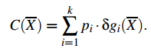
Except Model Change
the expected model change C(X) with respect to the instance X
δgi(X) be the change in the gradient with respect to the model parameters
p_{i} be the posterior probability of the instance i with respect to the current label set in the training data
Notes:
（1）那么实例X对模型造成的改变可以定于如下：。其中δgi(X) 表示在待查询实例为X，训练标记为i的情况下，与模型参数相关的目标函数的梯度的改变。Pi表示训练数据的当前标记集中标记i的后验概率.
（2）C（x）最大值对于的实例就是我们要查询的实例。
（1）label those points that would most change the current model
（2）Another general active learning framework uses a decision-theoretic approach, selecting the instance that would impart the greatest change to the current model if we knew its label. （2）A decision theoretic-approach is to select the instance that results in the greatest change from the current model. Specifically, the instance that results in the greatest change in gradient of the objective function with respect to the model parameters is used. The intuition of such an approach is to use an instance that is most different from the current model that is already known.
（3）Such an approach is only applicable to models where gradient-based training is used, such as discriminative probabilistic models.
（4）Let δgi(X) be the change in the gradient with respect to the model parameters, if the training label of the candidate instance X (with unknown label) is i.
Let pi be the posterior probability of the instance i with respect to the current label set in the training data. Then, the expected model change C(X) with respect to the instance X is defined as follows:
（5）The instance X with the largest value of C(X) is queried for the label.

Slide 28
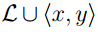
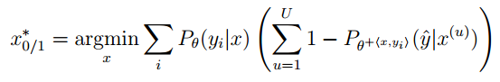
Except Error Reduction
Idea
label those points that would most reduce the model‘s generalization error.
The idea is to estimate the expected future error of a model trained using
on the remaining unlabeled instances in U , and query the instance with minimal expected future error .
where refers to the the new model after it has been re-trained with the training tuple <x,y>added to L.
Notes:
（1）现在我们看下Performance-based models 的策略，首先是Except Error Reduction（rui da ke xun）。它的主要思想是标记那些能够最大程度减少模型泛化误差的实例。
（2）因此该策略需要度量训练后模型的泛化误差。具体公式如下：。其中U代表剩余未标记的实例集合。θ+<x,y>代表将元组<x,y>添加到L进行训练后的新模型。（可不说）L代表已标记实例的集合。
（3）（4）
（1） label those points that would most reduce the model‘s generalization error （2）Another decision-theoretic approach aims to measure not how much the model is likely to change, but how much its generalization error is likely to be reduced. The idea it to estimate the expected future error of a model trained using L [ hx; yi on the remaining unlabeled instances in U and query the instance with minimal expected future error
（3）One approach is to minimize the expected 0/1-loss:
where θ+hx;yii refers to the the new model after it has been re-trained with the training tuple hx; yii added to L. Note that, as with EGL in the previous section, we do not know the true label for each query instance, so we approximate using expectation over all possible labels under the current model θ. The objective here is to reduce the expected total number of incorrect predictions. （4）Another, less stringent objective is to minimize the expected log-loss:
which is equivalent to reducing the expected entropy over U. Another interpretation of this strategy is maximizing the expected information gain of the query x, or (equivalently) the mutual information of the output variables over x and U. （5）In most cases, unfortunately, expected error reduction is also the most computationally expensive query framework. Not only does it require estimating the expected future error over U for each query, but a new model must be incrementally re-trained for each possible query labeling, which in turn iterates over the entire pool. This leads to a drastic increase in computational cost. （6）Because of this, the applications of the expected error reduction framework have mostly only considered simple binary classification tasks. Moreover, because the approach is often still impractical, researchers must resort to Monte Carlo sampling from the pool to reduce the U term in the previous analysis, or use approximate training techniques to reduce the G term.

Slide 29
Except Error Reduction
Note
approximate using expectation over all possible labels under the current model θ.
Shortcoming
In most cases, unfortunately, expected error reduction is also the most computationally expensive query framework.
require estimating the expected future error over U for each query
a new model must be incrementally re-trained for each possible query labeling
The applications of the expected error reduction framework have mostly only considered simple binary classification tasks.
Notes:
（1）这里需要注意的而是，因为我们不知道每个待查询实例的真实标记，所以我们在当前模型下，对实例所有可能的标记使用期望值。
（2）然而在大多数情况下，该策略是计算开销最大的策略之一。因为它不仅需要预估每个查询的期望误差，还需要对每个可能的查询标记进行重新培训。因此，该策略基本只适用于简单的分类问题。
(1) Whereas uncertainty sampling maximizes the label uncertainty of the queried instance, the expected error reduction minimizes the expected label uncertainty of the remaining instances V, when the queried instance is added to the data. (2) Thus, in the case of a binary-classification problem, we would like the labels of the instances in V to be as far away from 0.5 as possible （3）The idea here is that it is good to query for instances, which results in greater certainty of class label for the remaining error rate. （4）The assumption is that greater certainty of class labels of the remaining unlabeled instances corresponds to a lower error rate. （5）Let pi(X) denote the posterior probability of the label i for the instance X, before the queried instance is added. Let P(jX,i)(Z) be the posterior probability of class label j, when the instance-label combination (X,i) is added to the model. Then, the error objective function E(X,V) for the binary class problem (i.e., k = 2) is defined as follows: （6）The value of E(X,V ) is maximized rather than minimized (as in the case of uncertainty-based models). Furthermore, the error objective is a function of both the queried instance and the set of unlabeled instances V. This result can easily be extended to the case of k-way models by using the entropy criterion, as was discussed in the case of uncertainty-based models. In that case, the expression above is modified to replace ||P(jX,i)(Z) - 0.5|| with the class-specific entropy term -P(X,i) j (Z) · log(P(jX,i)(Z)). Furthermore, this criterion needs to be minimized. In this context, the minimization of the expression can be viewed as the minimization of the expected loss function.
（7）One observation about the afore-mentioned error reduction method of Equation 22.1 is that it needs to be computed in terms of the entire set of unlabeled instances in V, and a new model needs to be trained incrementally, in order to test the effect of adding a new instance 。The model is therefore expensive to compute.

Slide 30
Except Variance Reduction
It should be pointed out that when the error of an instance set reduces, the corresponding variance also typically reduces.
The overall generalization error can be expressed as a sum of the true label noise, model bias, and variance .Of these, only the last term is highly dependent on the choice of instances selected.
Therefore, it is possible to reduce the variance instead of the error, and the main advantage of doing so is the reduction in computational requirements.
Notes:
（1）上面介绍的Except Error Reduction（rui da ke xun）的计算开销太大，为了减轻这种开销，提出了Except Variance （wai rui en si）Reduction这种策略。
（2）当一个实例集的误差减少时候，相应的方差也会减少。总的泛化误差可以表示为真实标签噪声、模型偏差和方差之和，只有最后一项方差高度依赖于选择的实例。
（3）因此，我们可以通过可以度量并减少方差的方法等效于之前的误差减少策略，这样做的主要好处是减少了计算需求。具体的内容在此不做陈述。
（1）One observation about the afore-mentioned error reduction method of Equation 22.1 is that it needs to be computed in terms of the entire set of unlabeled instances in V, and a new model needs to be trained incrementally, in order to test the effect of adding a new instance. The model is therefore expensive to compute.
（2） It should be pointed out that when the error of an instance set reduces, the corresponding variance also typically reduces. The overall generalization error can be expressed as a sum of the true label noise, model bias, and variance 。Of these, only the last term is highly dependent on the choice of instances selected. Therefore, it is possible to reduce the variance instead of the error, and the main advantage of doing so is the reduction in computational requirements. （2）The main advantage of these techniques is the ability to express the variance in closed form, and therefore achieve greater computational efficiency.

Slide 31
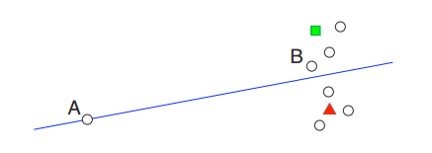
Constrast
Figure below illustrates this problem for a binary linear classifier using uncertainty sampling.
The least certain instance lies on the classification boundary, but is not “representative” of other instances in the distribution.
Querying B is likely to result in more information about the data distribution as a whole.
The estimated error and variance reduction strategies implicitly avoid these problems.
Notes:
（1）之前我们说到的错误和方差减少策略的中心思想是，它们关注的是整个输入空间，而不是单个实例。因此，与不确定性抽样、Query-By-Committee （kang mi tei）和Expected Model Change 等更简单的查询策略相比，它们不容易查询到异常值。
（2）上图展示了使用不确定性采样处理二元线性分类的问题.途中有颜色的表示已经标记的实例，圆圈表示尚未标记的实例，A位于决策边界上，因此会被认为最难确定标记的实例，
，但是它相较于图中其他实例并没有代表性，因此即使知道该实例的真实标记也不太可能提高数据整体上的准确度。相反查询B点可能会产生更多关于整个数据分布的信息。
（3）同样的，Query-by-Committee和Except Model Change可能会导致相同的问题，但是the error and variance reduction 策略在使用未标记的实例池来评估泛化误差和方差时，却可以隐式地避免这些问题。
（1）A central idea of the estimated error and variance reduction frameworks is that they focus on the entire input space rather than individual instances. Thus, they are less prone to querying outliers than simpler query strategies like uncertainty sampling, QBC, and EGL.
（2）Figure 7 illustrates this problem for a binary linear classifier using uncertainty sampling. The least certain instance lies on the classification boundary, but is not “representative” of other instances in the distribution, so knowing its label is unlikely to improve accuracy on the data as a whole.
QBC and EGL may exhibit similar behavior, by spending time querying possible outliers simply because they are controversial, or are expected to impart significant change in the model.
By utilizing the unlabeled pool U when estimating future errors and output variances, the estimated error and variance reduction strategies implicitly avoid these problems.
We can also overcome these problems by modeling the input distribution explicitly during query selection.

Slide 32
Representativeness-Based Models
Representativeness can be achieved by querying the data in such a way that the acquired instances tend to resemble the overall distribution better.
This is achieved by weighting dense regions of the input space to a higher degree during the querying process.
combine the heterogeneity behavior of the queried instance with a representativeness function from the unlabeled set V in order to decide on the queried instance.
Notes:
（1）最后一种查询策略框架是Representativeness-Based Models。在这里代表性能够通过查询可以很好模拟数据整体分布的实例实现，因此可以在查询过程中对输入空间的密集区域进行加权。类似的方法就包括下面将要介绍的Density-Weight Methods。
（2）这类方法将被查询的实例的异质性行为与从未标记的集合V中得到的代表性函数结合起来，以决定查询的实例。
（1）The main advantage of error-based models over uncertainty-based models is that they intend to improve the error behavior on the aggregate, rather than looking at the uncertainty behavior of the queried instance, as in heterogeneity-based models. Therefore, unrepresentative or outlierlike queries are avoided.
（2）However, representativeness can also be achieved by querying the data in such a way that the acquired instances tend to resemble the overall distribution better. This is achieved by weighting dense regions of the input space to a higher degree during the querying process. Examples of such methods include density-based models
（3）Therefore, these methods combine the heterogeneity behavior of the queried instance with a representativeness function from the unlabeled set V in order to decide on the queried instance.
（4）Therefore, in general, the objective function O(X,V) of such a model is expressed as the product of a heterogeneity component H(X) and a representativeness component R(X,V ):
（5）The value of H(X) (assumed to be a maximization function) can be any of the heterogeneity criteria (transformed appropriately for maximization) such as the entropy criterion En(X) from uncertainty sampling, or the expected model change criterion C(X). （6）The representativeness criterion R(X,V) is simply a measure of the density of X with respect to the instances in V. A simple version of this density is the average similarity of X to the instances in V ，though it is possible to use more sophisticated methods such as kernel-density estimation to achieve the same goal. （7）Note that such an approach is likely to ensure that the instance X is in a dense region, and is therefore not likely to be an outlier.

Slide 33
Representativeness-Based Models
The objective function
Where H(X) is the product of a heterogeneity component
any of the heterogeneity criteria , such as the entropy criterion En(X) from uncertainty sampling
R(X,V) is a representativeness component
a measure of the density of X with respect to the instances in V.
ensure that the instance X is in a dense region, and is therefore not likely to be an outlier.
Notes:
（3）目标函数如下，其中H(X)是异质性相关的组成成分，其值可以是任何异质性规范，例如不确定性抽样中的熵En（X），R(X,V)是一个代表性的组成成分.
（4）因此这类方法可以确保实例X位于一个密度较高的区域，因此不太可能是一个异常值。
（1）The main advantage of error-based models over uncertainty-based models is that they intend to improve the error behavior on the aggregate, rather than looking at the uncertainty behavior of the queried instance, as in heterogeneity-based models. Therefore, unrepresentative or outlierlike queries are avoided.
（2）However, representativeness can also be achieved by querying the data in such a way that the acquired instances tend to resemble the overall distribution better. This is achieved by weighting dense regions of the input space to a higher degree during the querying process. Examples of such methods include density-based models
（3）Therefore, these methods combine the heterogeneity behavior of the queried instance with a representativeness function from the unlabeled set V in order to decide on the queried instance.
（4）Therefore, in general, the objective function O(X,V) of such a model is expressed as the product of a heterogeneity component H(X) and a representativeness component R(X,V ):
（5）The value of H(X) (assumed to be a maximization function) can be any of the heterogeneity criteria (transformed appropriately for maximization) such as the entropy criterion En(X) from uncertainty sampling, or the expected model change criterion C(X). （6）The representativeness criterion R(X,V) is simply a measure of the density of X with respect to the instances in V. A simple version of this density is the average similarity of X to the instances in V ，though it is possible to use more sophisticated methods such as kernel-density estimation to achieve the same goal. （7）Note that such an approach is likely to ensure that the instance X is in a dense region, and is therefore not likely to be an outlier.

Slide 34
Density-Weight Methods
Main idea
Informative instances should not only be those which are uncertain, but also those which are “representative” of the underlying distribution.
Notes:
（1）下面我们简单介绍一下Density（deng sui tei）-Weight Methods。它的主要思想是我们要查询的实例，应该不仅仅是难以确定标记的，也应该包括能够代表底层数据分布的实例（例如在输入空间的密集区域内）。
（3）The information density framework described by Settles and Craven (2008), and further analyzed in Chapter 4 of Settles (2008), is a general density-weighting technique.
The main idea is that informative instances should not only be those which are uncertain, but also those which are “representative” of the underlying distribution (i.e., inhabit dense regions of the input space). Therefore, we wish to query instances as follows:
（4）Here, φA(x) represents the informativeness of x according to some “base” query strategy A, such as an uncertainty sampling or QBC approach. The second term weights the informativeness of x by its average similarity to all other instances in the input distribution (as approximated by U), subject to a parameter β that controls the relative importance of the density term. A variant of this might first cluster U and compute average similarity to instances in the same cluster.

Slide 35
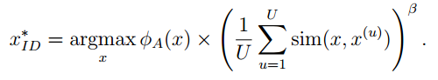
Density-Weight Methods
The objective function
φA(x) represents the informativeness of x according to some “base” query strategy A, such as an uncertainty sampling or QBC approach.
The second term weights the informativeness of x by its average similarity to all other instances in the input distribution (as approximated by U), subject to a parameter β that controls the relative importance of the density term.
Notes:
（2）这个方法的目标函数如下：。其中这个φA(x) 代表根据某个基础查询策略，比如不确定性采样，得到的实例X的信息，右边这个表示实例X与其他实例的平均相似度。贝塔控制着右边这项在这个函数中的相对重要程度。
（3）这个函数值最大的实例，即为我们要查询的实例。
（3）The information density framework described by Settles and Craven (2008), and further analyzed in Chapter 4 of Settles (2008), is a general density-weighting technique.
The main idea is that informative instances should not only be those which are uncertain, but also those which are “representative” of the underlying distribution (i.e., inhabit dense regions of the input space). Therefore, we wish to query instances as follows:
（4）Here, φA(x) represents the informativeness of x according to some “base” query strategy A, such as an uncertainty sampling or QBC approach. The second term weights the informativeness of x by its average similarity to all other instances in the input distribution (as approximated by U), subject to a parameter β that controls the relative importance of the density term. A variant of this might first cluster U and compute average similarity to instances in the same cluster.

Slide 36
Theoretical Guarantees
王继欣
51174500128

Slide 37
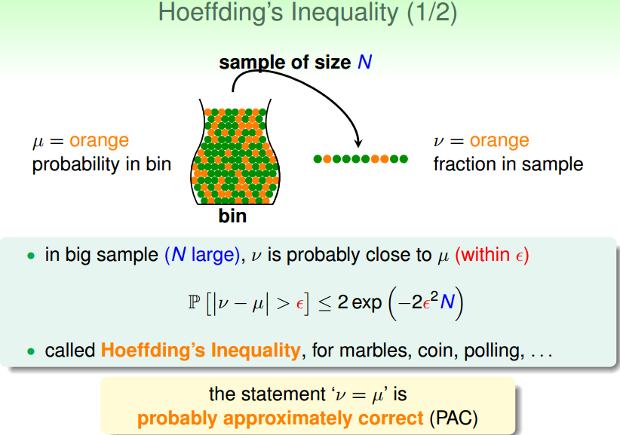
Notes:
首先我们来讲几个概念
有两个数量，一个μ是罐子里的比率，我们手上的比率。抽一把起来，数量是N。抽一把起来大致上说μ和new这两个数字会很接近，我们在数学上用一个误差哎来表示，数学上有一个定理说这件事发生的几率会很小，大家看有多小，它是2exp。。你的N越多，这个exp就越小，N很大，右边就很小。那什么很小，这两个数字如果差很远，比哎还远的话这个几率很小，比如罐子里都是黄色，你抽一把绿色，这两个数字就会相差很远的概率会很小，这个式子叫做霍夫丁不等式。。。如果抽样，看你抽的样本多大，如果够大的的话，的到的估计和你实际需要的值不会差的很多。最好的事情是μ和new一样，这句话大概差不多是对的，也就是PAC。

Slide 38
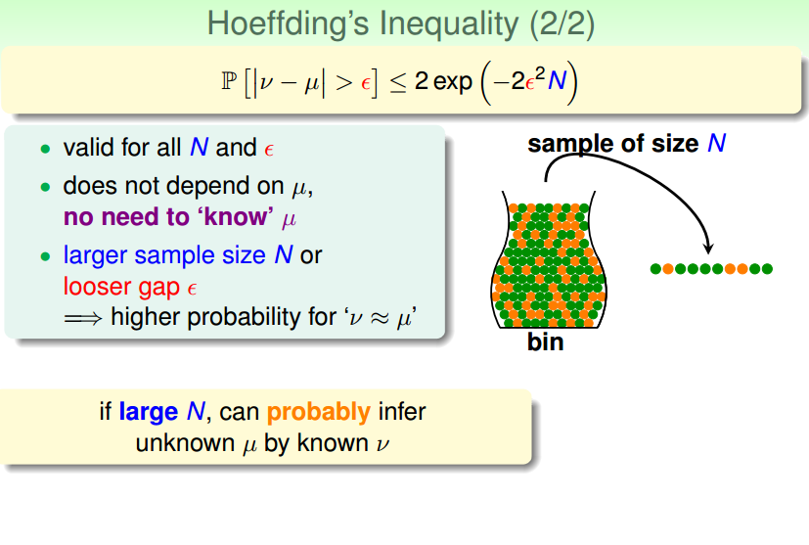
Notes:
不管你选择多少个样本和误差，这个式子都是对的
在这里右边他的几率跟μ无关既然跟μ无关，就根本不需要知道μ，我们本来就不知道μ，然后我们抽起来那个sample里的东西然后推论回来，霍夫丁提供我们这样的推论的原因是在这个式子里根本没有我们不知道的假设

Slide 39
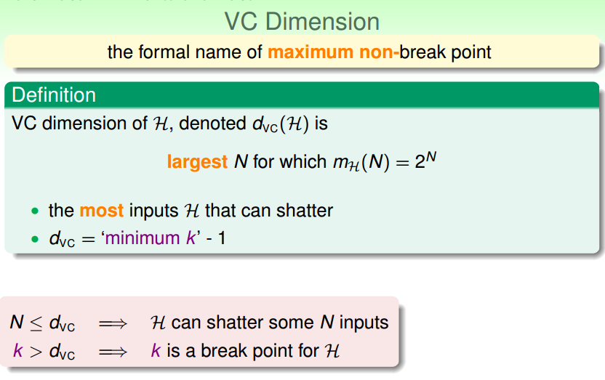
Notes:
然后是vc维，上节课也讲到了，这边就简要说一下。VC维是这么定义的，对于一个假设集H，如果存在N个样本能够被假设集中的函数按所有可能的2的N次方种形式分开，则称假设集能够把N个样本打散；假设集的VC维就是它能打散的最大样本数目N。

Slide 40
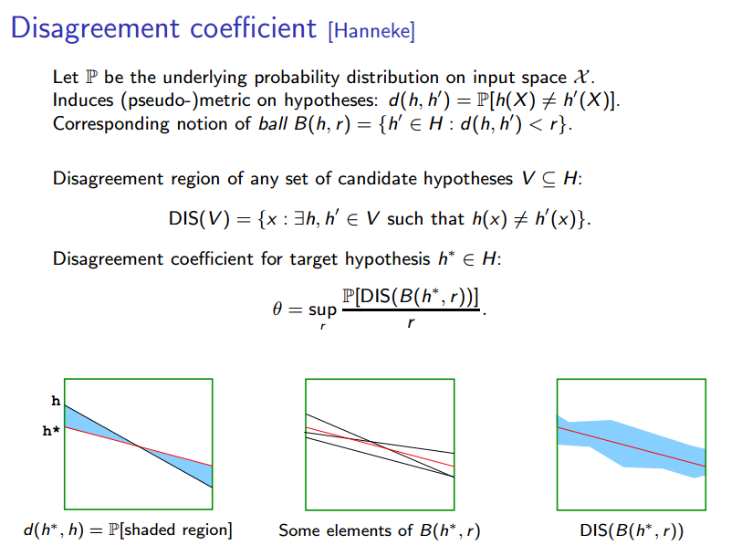
Notes:
不一致系数。主动学习的标签复杂性可以用他所谓的学习问题的不一致系数来表征。

Slide 41
Importance Weighted Active Learning
The algorithm uses importance weighting to correct sampling bias.
And by controlling the variance, we are able to give rigorous label complexity bounds for the learning process.
Notes:
下面我们通过一个具体的算法，即重要性加权主动学习来说明主动学习的理论保证。首先该算法使用重要性权重来纠正采样偏差。然后，通过控制不一致性（也就是之前提到的不一致系数），我们能够为学习过程提供严格的标签复杂性界限。

Slide 42
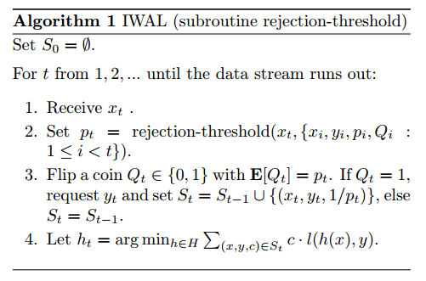
The basic outline of IWAL
Notes:
这个算法描述了重要性-加权主动学习主要流程。它获取查询是通过流的方式。首先设置S0为空集，1然后t从1开始接收数据xt直到数据流用完。2当看到Xt时，学习者调用子程序拒绝阈值（在后面的部分中实例化），它查看Xt和过去的历史来返回请求Yt的概率Pt。该算法维护迄今为止看到的一组标记的示例，每个都具有重要权重：如果Yt最终被查询，则其权重设置为1 /Pt。3通过E【】=Pt来决定Qt是属于0还是1，如果Qt=1，那么请求Yt并且把St设为。。否则。。。4令t时刻的假设函数ht为

Slide 43
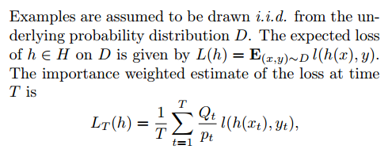
Subroutine rejection-threshold
Notes:
子程序拒绝阈
在时间T的损失的重要性加权估计是Lt
其中的Qt就是就是算法中定义

Slide 44
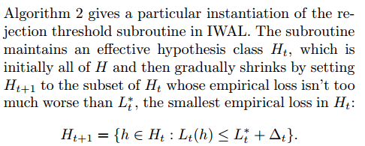
Notes:
下面算法2给出了IWAL中拒绝阈子程序的一个特定实例。 子程序保持一个有效的假设类Ht，它最初是整个H，然后通过将Ht + 1设置为Ht的子集来逐渐缩小，其经验损失不比L * t差太多，Ht*是Ht中最小的经验损失（度量模型平均意义下的预测好坏）

Slide 45
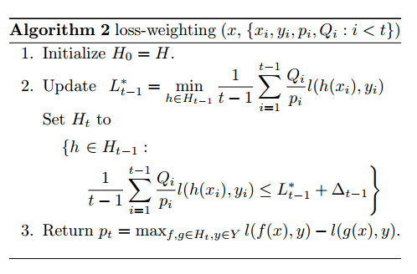
Notes:
我们下面将会说明，在很高的概率下，任何最优假设h *总是在Ht中，因此所有其他假设都可以被忽略。 对于每个xt，损失加权方案查看Ht中假设对xt的预测范围，并将采样概率pt设置为（大致）该范围的大小：精确地说，pt = maxf。 由于损失值被归一化为[0,1]，所以我们可以确定pt也在这个区间内。

Slide 46
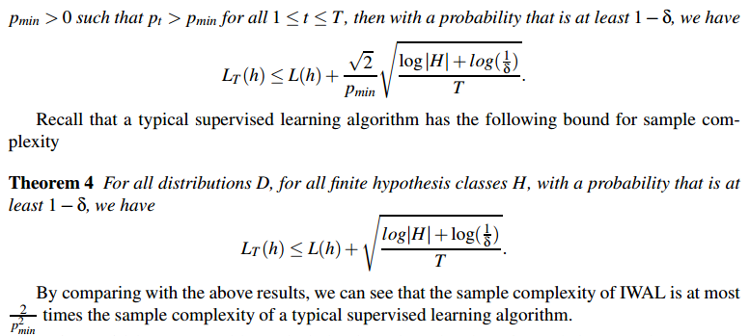
A safety guarantee
Notes:
任何学习算法的理想特性都是一致性：给定无标签和标记示例的无限预算，该算法是否会收敛到最佳预测值？ 一些早期的主动学习算法，如果这些点不能被给定的假设类别完全分类，则不能满足这个基本保证。 我们下面的定理证明IWAL算法是一致的，只要pt与0有界。 此外，在最坏的情况下，其样本复杂度在监督学习的常数因子内。下面看这两个定理。。。
可以通过使用PAC和VC维来分析证明这个定理3，L（h）是在时间T时损失的期望值，E[LT(h)]=L(h)

Slide 47
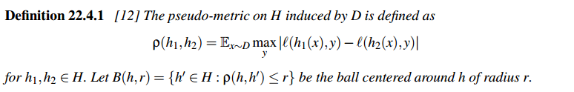
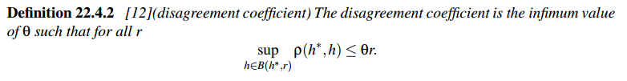
Label Complexity
Notes:
假设我们有一串T例子，其中一些标签被查询。 一致性分析告诉我们，在IWAL算法结束时，IWAL输出的分类器与被看作所有T标签的被动监督学习算法选择的分类器相当。 剩下的问题是IWAL询问这些T例子中的多少个标签。 换句话说，IWAL的标签复杂程度如何？ 下面证明IWAL可以大大提高标签复杂性。
该算法的界限主要取决于特定的数量，称为不一致系数，这取决于假设空间和示例分布。 刚开始讲不一致系数是针对0 - 1损失函数定义的。 这里我们需要一般的不一致系数用于一般损失函数？（z，y）。 不一致系数的定义需要一些新的概念。
由D引发的H上的伪量度被定义为
不一致系数是θ的最小值，因此对于所有的r

Slide 48
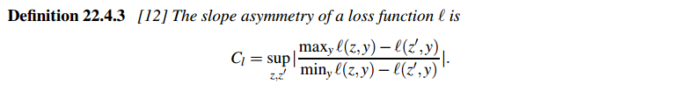
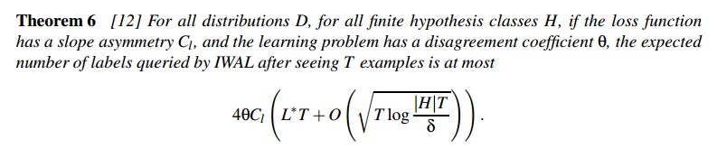
Upper Bound on Label Complexity
Notes:
损失函数L的斜率不对称性为。。。sup上确界，对所有的z，z‘取最大值。
对于所有分布D，对于所有有限假设类别H，如果损失函数具有斜率不对称性Cl，并且学习问题具有不一致系数θ，则在看到T示例之后IWAL查询的标签的期望数目最多为
其中L *是D上由H所能达到的最小损失

Slide 49
Advanced Methods
阳文灿 51174500141

Slide 50
Advanced Methods
主动学习可能会出现在不同场景中，例如基于特征的学习，流式数据或其他种类的查询变体。
Active Learning of Features
Active Learning of Kernels
Active Learning of Classes
Streaming Active Learning
Multi-Oracle Active Learning

Slide 51
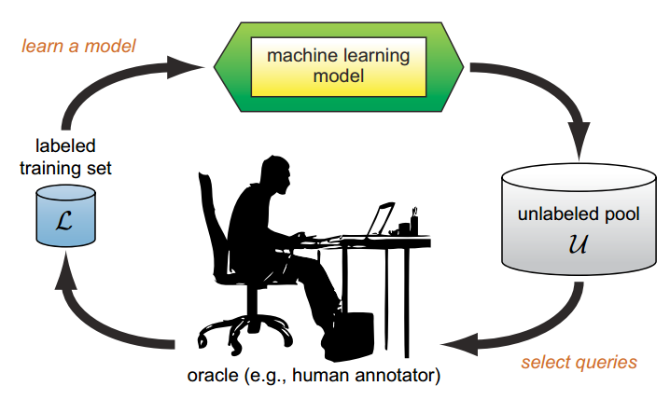
Multi-Oracle Active Learning
在传统的主动学习假设中：
系统中只有一个“预言者”
该“预言者”知道所有的分类标签
该“预言者”所有的标签都是正确的

Slide 52
Multi-Oracle Active Learning
BUT!
这些假设在实际应用中可能是不成立的:
找到这样一个知道一切的“预言者”是非常困难或不可能的。
每个“预言者”（即标注者）只知道或熟悉问题的其中一小部分。
个人“预言者”的答案可能不够准确。必须将多个“预言者”的 答案做结合。
例如：患者检查报告

Slide 53
Multi-Oracle Active Learning
BUT!
这些假设在实际应用中可能是不成立的:
找到这样一个知道一切的“预言者”是非常困难或不可能的。
每个“预言者”（即标注者）只知道或熟悉问题的其中一小部分。
个人“预言者”的答案可能不够准确。必须将多个“预言者”的 答案做结合。
例如：患者检查报告
因此我们需要求助于具有不同专业知识的多个“预言者”（multiple oracles）

Slide 54
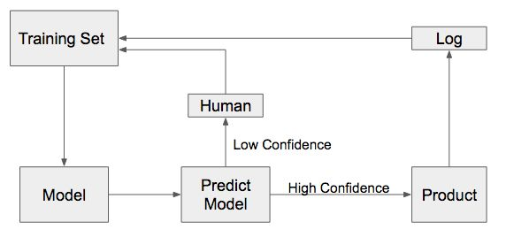
Multi-Oracle Active Learning
众包系统（Crowdsourcing systems）
亚马逊劳务众包平台（Amazon Mechanical Turk）
随着机器学习应用到越来越多的领域，有越来越多的数据需要被标记。
Turkers（Oracles）来自不同领域，具有不同知识背景，可标记不同领域的数据，或统一数据的不同属性。
训练人工智能系统

Slide 55
Multi-Oracle Active Learning
两个选择：
选择需要被标签的实例
选择合适的标注者
实例选择问题（ instance-selection problem）
实例-预言者对选择问题（instance-oracle-pair selection problem）
新的挑战

Slide 56
Multi-Oracle Active Learning
新的挑战：
为了最有利于训练学习模型，需要估计每个未标记实例的重要性以及每个标注者的专业性。
“Active Learning from Crowds”
28th International Conference on Machine Learning（ICML）
—Yan Yan
ECE Department, Northeastern University, Boston, MA USA
—Romer Rosales
Yahoo! Labs, Santa Clara, CA USA
—Glenn Fung
CAD and Knowledge Solutions, Siemens Healthcare, Malvern, PA USA

Slide 57
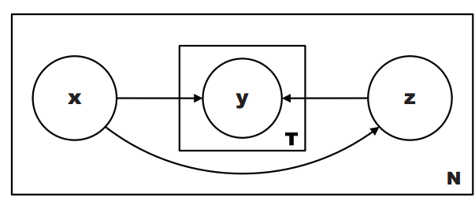
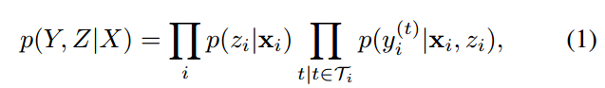
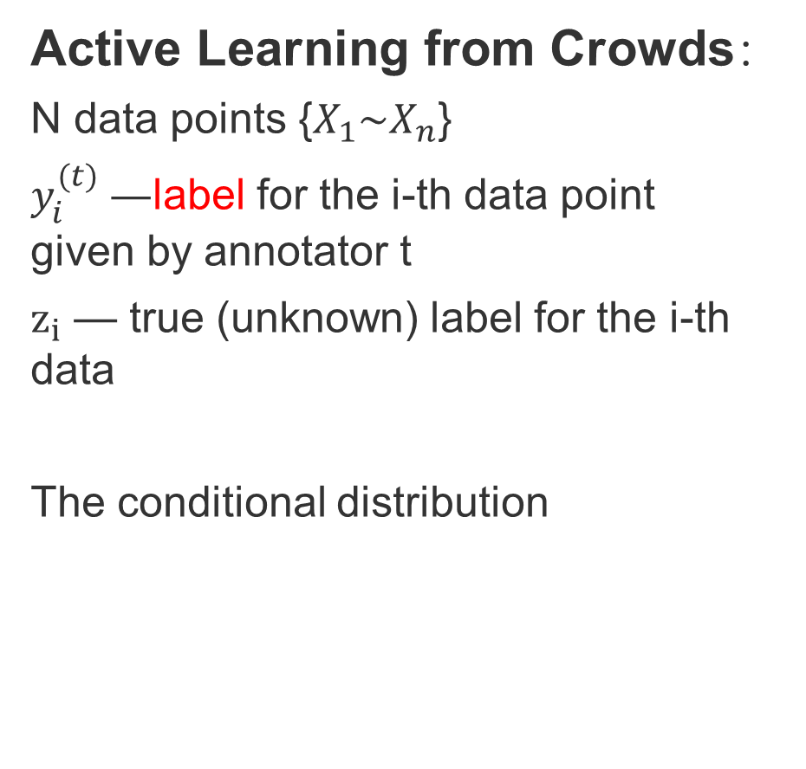
Multi-Oracle Active Learning
Active Learning from Crowds：
N data points {$X_{1}\sim X_{n}$}
$y_{i}^{(t)} —$label for the i-th data point given by annotator t
$z_{i}$ — true (unknown) label for the i-th data
The conditional distribution

Slide 58
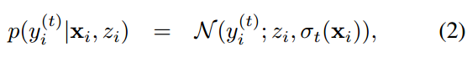
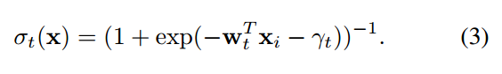
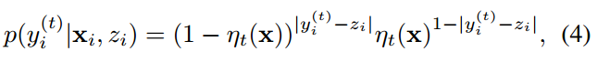
Multi-Oracle Active Learning
Active Learning from Crowds：
Labeler model：
A Gaussian model:
A Bernoulli model:

Slide 59
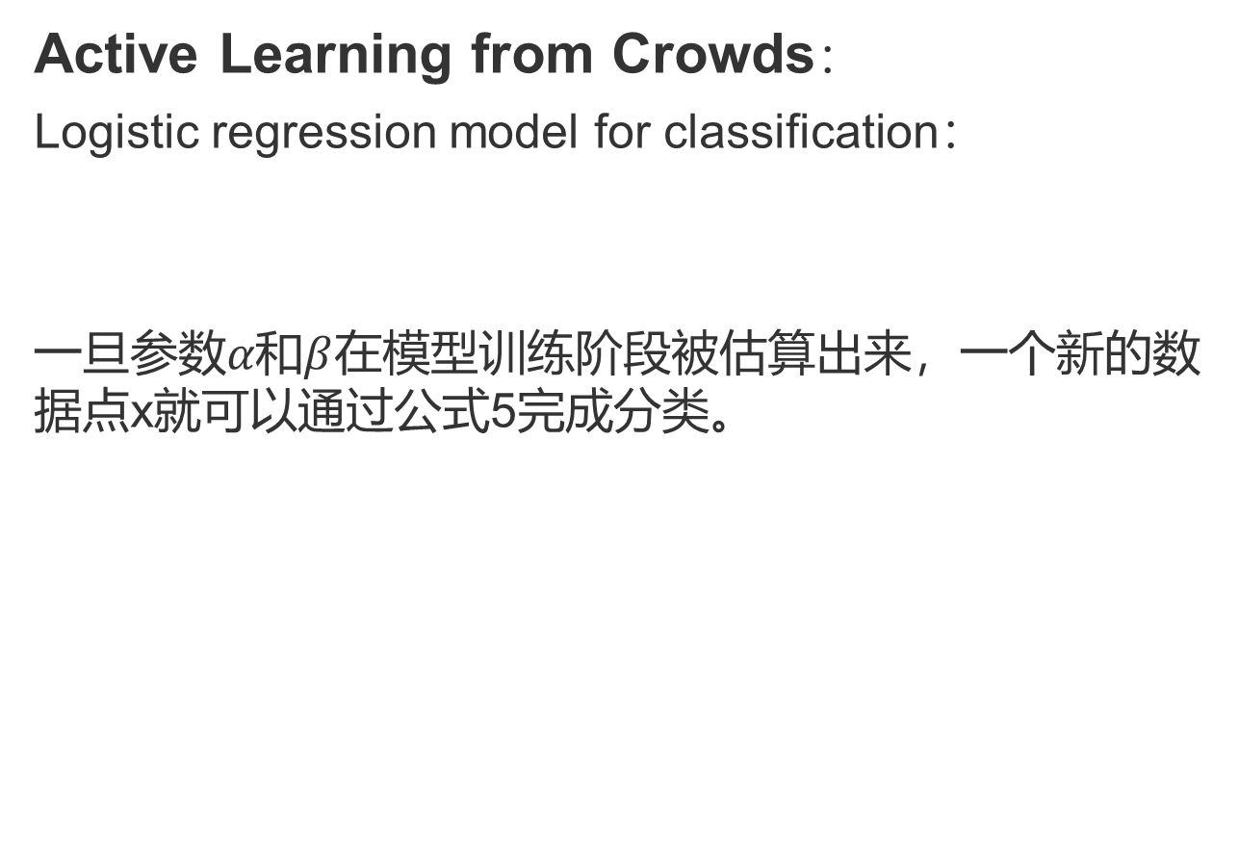
Multi-Oracle Active Learning
Active Learning from Crowds：
Logistic regression model for classification：
一旦参数$α和β$在模型训练阶段被估算出来，一个新的数据点x就可以通过公式5完成分类。

Slide 60
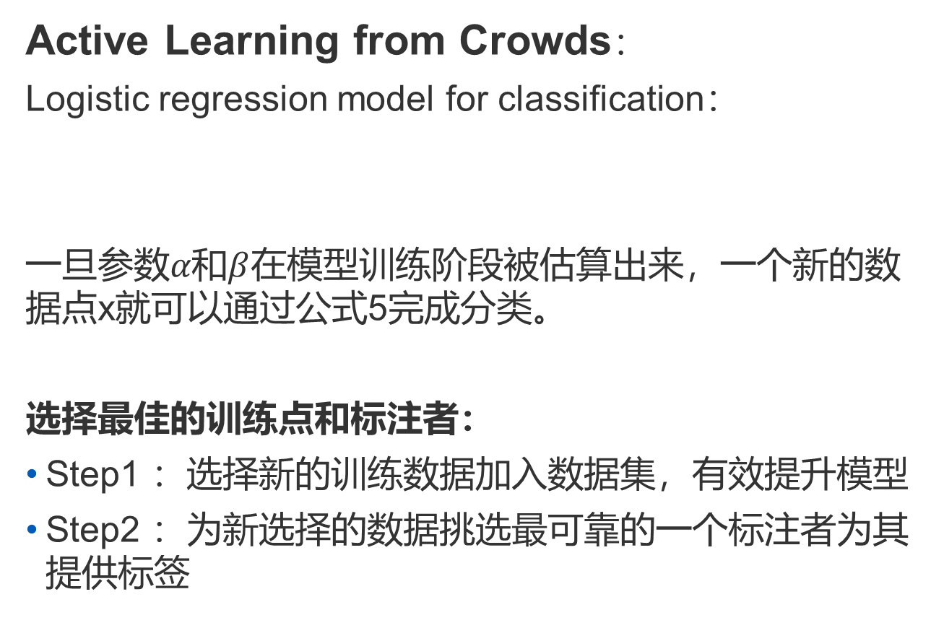
Multi-Oracle Active Learning
Active Learning from Crowds：
Logistic regression model for classification：
一旦参数$α和β$在模型训练阶段被估算出来，一个新的数据点x就可以通过公式5完成分类。
选择最佳的训练点和标注者：
Step1 ：选择新的训练数据加入数据集，有效提升模型
Step2 ：为新选择的数据挑选最可靠的一个标注者为其提供标签

Slide 61
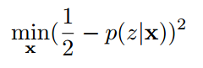
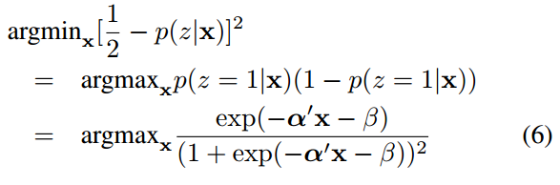
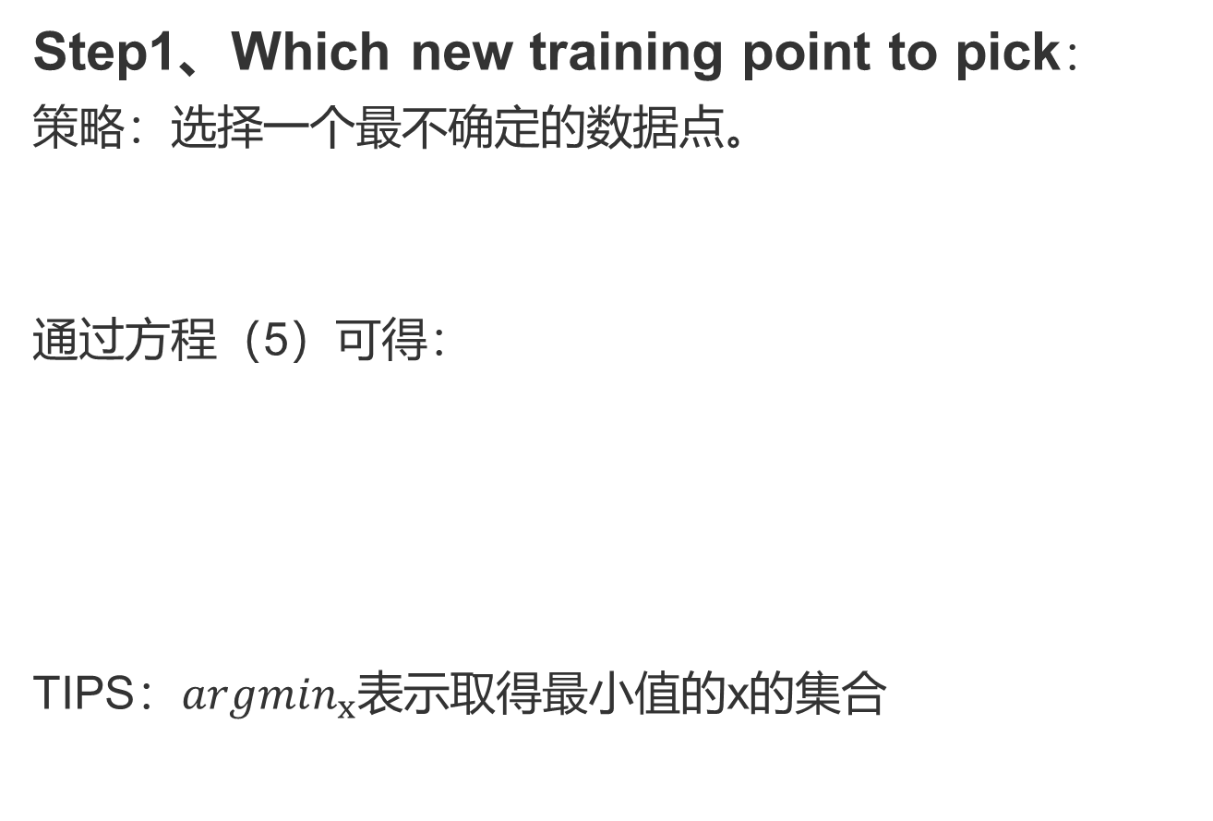
Multi-Oracle Active Learning
Step1、Which new training point to pick：
策略：选择一个最不确定的数据点。
通过方程（5）可得：
TIPS：${argmin}_{x}$表示取得最小值的x的集合

Slide 62
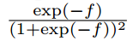
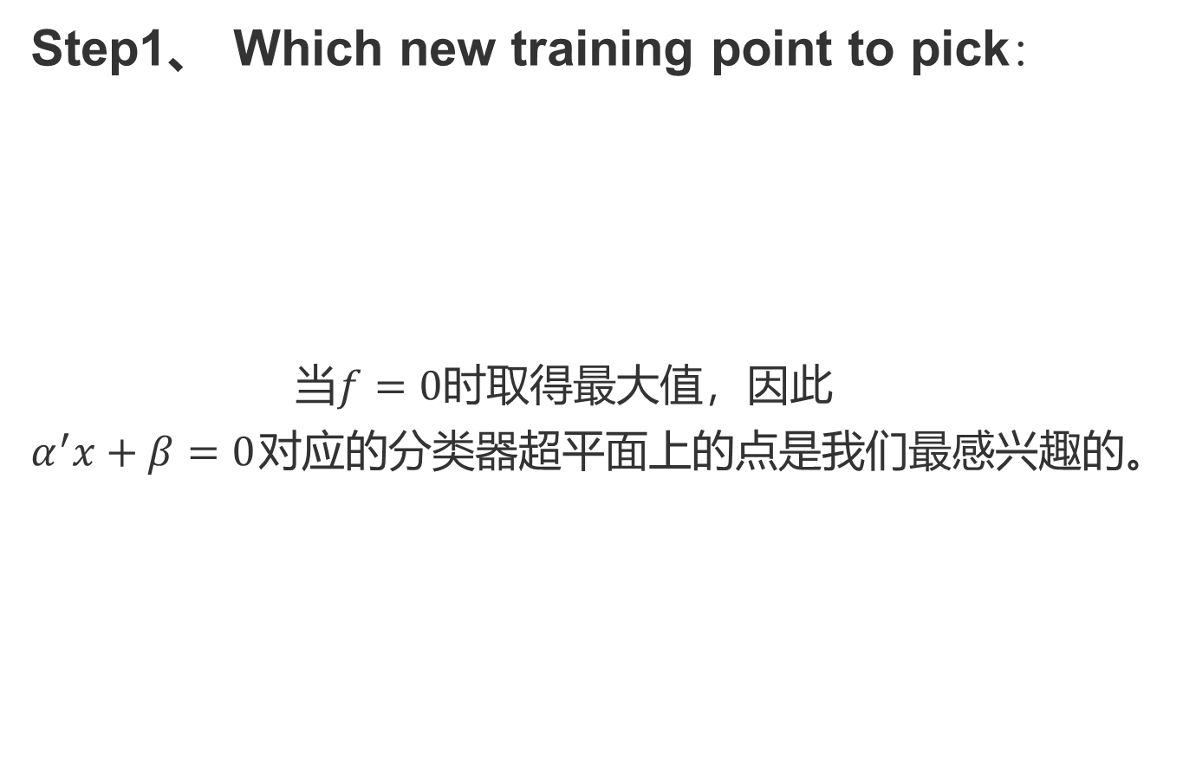
Multi-Oracle Active Learning
Step1、 Which new training point to pick：
当$f=0时$取得最大值，因此
$α^{′}x+β=0$对应的分类器超平面上的点是我们最感兴趣的。

Slide 63
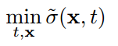
Multi-Oracle Active Learning
Step2、 Which expert to pick：
表明了标注者的可靠性，因此选择标注者的问题就变为：
这个问题非常复杂且计算量大（解决方案非凸，不可微分）

Slide 64
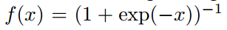
Multi-Oracle Active Learning
Step2、 Which expert to pick：
表明了标注者的可靠性，因此选择标注者的问题就变为：
这个问题非常复杂且计算量大（解决方案非凸，不可微分）
单调非递减

Slide 65
Multi-Oracle Active Learning
Step2、 Which expert to pick：
表明了标注者的可靠性，因此选择标注者的问题就变为：
这个问题非常复杂且计算量大（解决方案非凸，不可微分）
转换成为一个双凸优化问题：
单调非递减

Slide 66
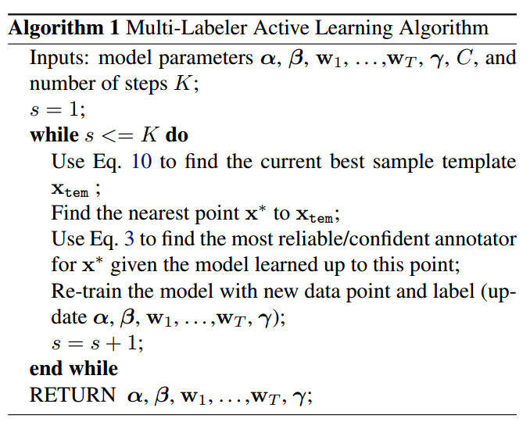
Multi-Oracle Active Learning

Slide 67
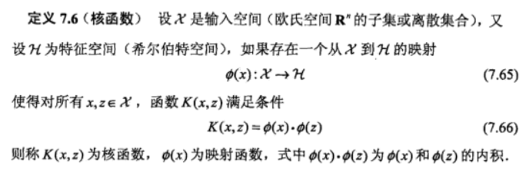
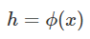
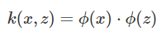
Active Learning of Kernels
Kernel是什么？
核函数
假设X是输入空间，H是特征空间，存在一个映射ϕ使得X中的点x能够计算得到H空间中的点h ，
对于所有的X中的点都成立，x，z是X空间中的点。函数k(x,z)满足条件：
则称k为核函数，而ϕ为映射函数。

Slide 68
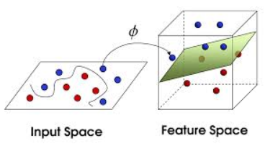
Active Learning of Kernels
Kernels作用：
低维空间映射到
高纬空间实现线性可分
减少计算复杂度
由于其在数据聚类，分类和降维方面的优越性能，引起了计算机科学和工程研究人员的越来越多的关注。
运用领域：
模式识别
信息检索
计算机视觉
生物信息学等

Slide 69





Active Learning of Kernels
什么样的函数才可以叫做核函数：
常用的核函数：
线性核：
多现实核：
高斯核：
指数核：
拉普拉斯算子核

Slide 70
Active Learning of Kernels
由于核函数或矩阵的选择对于许多基于内核的学习技术的性能常常是至关重要的，因此如何自动学习给定数据集的核函数/矩阵成为越来越重要的研究问题。
一部分研究从设计选择性抽样方法的角度提高监督学习的有效性。
基于内核的方法（Kernel-based methods）在监督学习中也是非常重要和有效的，在学习过程中起重要作用的是核函数/矩阵而不是特征值。
具体而言：
主动内核学习就是利用主动学习的方法以最小标记成本学习数据集的最优核函数/矩阵的问题。

Slide 71
Active Learning of Kernels
“Active Kernel Learning”
25th International Conference on Machine Learning（ICML）
—Steven C.H. Hoi
School of Computer Engineering, Nanyang Technological University, Singapore
—Rong Jin
Department of Computer Science and Engineering, Michigan State University

Slide 72
Active Learning of Kernels
背景：
已经提出的许多学习算法来从辅助信息中学习核函数或矩阵。
辅助信息的两种提供方式：标记示例（labeled examples ）或约束对（pairwise constraints ）。
有些时候标记获取辅助信息代价非常高
TIP：约束对
must-link pair
cannot-link pair

Slide 73

Active Learning of Kernels
Active Kernel Learning：
目标：找出对目标内核有用的数据对.
策略：
给定一对实例（$χ_{i}$，$χ_{j}$），对应的内核值$Κ_{i,j}表明$了$χ_{i}和χ_{j}$之间的相似程度：
如果两个实例在同一个类中，那么$Κ_{i,j}$通常是一个很大的正数。
如果两个实例在不同类中，那么$Κ_{i,j}$通常是一个很大的负数。
主动内核学习选择最接近零的内核相似度。

Slide 74
Active Learning of Kernels
Active Kernel Learning：
目标：找出对目标内核有用的数据对.
策略：
给定一对实例（$χ_{i}$，$χ_{j}$），对应的内核值$Κ_{i,j}表明$了$χ_{i}和χ_{j}$之间的相似程度：
如果两个实例在同一个类中，那么$Κ_{i,j}$通常是一个很大的正数。
如果两个实例在不同类中，那么$Κ_{i,j}$通常是一个很大的负数。
主动内核学习选择最接近零的内核相似度。

Slide 75
相关的机器学习算法
王伟成
51174500130
Notes:
在前面的介绍中，我们已经了解到主动学习的主要理论依据和具体算法过程。主动学习的研究主要是受两个关键思想的驱动：一是学习者不应该是严格被动的，二，无标签的数据往往更容易获得。
那么基于这两种思想，我们再介绍两种与主动学习密切相关的学习算法。

Slide 76

半监督学习
Notes:
我们已经了解到主动学习在学习过程中额外引入了专家知识，通过与外界的交互来将部分未标记样本转变为有标记样本。那么如果没有与专家交互，没有获得额外信息，该如何利用未标记样本来提高泛化性能呢，这里，我们讨论半监督学习算法。
事实上，未标记样本虽然未直接包含标记信息，但如果他们与有标记样本是从同样的数据源独立同分布采样而来，则他们所包含的数据分布的信息对建立模型是大有帮助的。
这里给出了一个直观的示例，如果仅基于图中的一个正例和反例，则由于待判别样本正好处于两者正中间，所以大体上只能随机猜测样本的属性，如果能观察到图中的未标记样本，则有很大概率判断出其为正例。
所以相对于主动学习，简而言之，让学习器不依赖外界交互、自动地利用未标记样本来提升学习性能，就是半监督学习。

Slide 77

半监督学习
Notes:
半监督学习可进一步划分为纯半监督学习和直推学习 ，前者假定训练数据中的未标记样本并非待预测的数据，而后者则假定学习过程中所考虑的未标记样本恰是待预测数据，学习的目的就是在这些未标记样本上获得最优泛化性能。所以换句话说，纯半监督学习是基于"开放世界”的假设，希望学得模型能适用于训练过程中未观察到的数据;
而直推学习是基于“封闭世界”假设，仅试图对学习过程中观察到的未标记数据进行预测
这里图中直观地显示出主动学习、纯半监督学习、直推学习的区别。

Slide 78

强化学习
Notes:
下面呢，我们介绍一下强化学习，同主动学习一样，在强化学习中，学习者需要通过“行为”与外界进行交互，并试图找到最佳的行为策略，同时需要从环境中获得“回报”。
但是当我们执行某个操作时，并不能立即获得最终结果甚至难以判断当前操作对最终结果的影响，仅能获得一个当前反馈。
这里，我们给出了强化学习的一个简单图示.强化学习任务通常用马尔可夫决策过程来描述:机器处于环境 E 中，状态空间为 X，其中每个状态 x 是机器感知到的环境的描述，我们以种瓜任务为例的话，X 就是当前瓜苗长势的描述; 机器能采取的动作构成了动作空间 A ，如种瓜过程中有浇水、施不同的肥、使用不同的农药等多种可供选择的动作;若某个动作 α作用在当前状态 x上，则潜在的转移函数 P 将使得环境从当前状态，按某种概率转移到另一个状态A2，如瓜苗状态为缺水，若选择动作浇水，则瓜苗长势会发生变化，瓜苗有一定的概率恢复健康，也有一定的概率无法恢复;在转移到另一个状态的同时，环境会根据潜在的”奖赏" 函数 R 反馈给机器一个奖赏，如保持瓜苗健康对应奖赏 +1，瓜苗凋零对应奖赏-10，最终种出了好瓜对应奖赏 +100.

Slide 79

强化学习
Notes:
这里是一个更为具体的给西瓜浇水的马尔科夫决策过程。机器要做的是通过在环境中不断地尝试而学得一个"策略" ，根
据这个策略，在状态 x下就能得知要执行的动作 α，例如看到瓜苗状态是缺水时，能返回动作"浇水”.策略的优劣取决于长期执行这一策略后得到的累积奖赏，例如某个策略使得瓜苗枯死，它的累积奖赏会很小，另一个策略种出了好瓜，它的累积奖赏会很大.在强化学习任务中，学习的目的就是要找到能使长期累积奖赏最大化的策略.
相对于主动学习，为了取得更优的结果，学习者必须积极主动。但是强化学习又很容易聚合在过去表现良好，但不够优化的策略上。所以为了改善策略，学习者必须承担一定风险并尝试不确定的行为。正如active learning 中的学习者请求不确定标签的实例。 这被称为 探索—利用 权衡策略。

Slide 80

强化学习
Notes:
然后关于主动学习和强化学习，这里再简单介绍一篇论文。这篇论文的题目是Using Active Relocation to Aid Reinforcement Learning。是德克萨斯大学发表在FLAIRS-2006上的，主要考虑使用一种明确的主动的强化学习方法，旨在减少强化学习过程中找到最有策略的总的步数。

Slide 81
强化学习
初级
中级
高级
重定位
Notes:
那么在之前的介绍中，我们已经知道了强化学习中，学习者为了习得一个策略需要不断的进行操作实现状态的转移，获得最大奖励。在这篇论文中就提出了一种框架来帮助学习者重定位到某个状态，以此来减少制定有效策略所需的步数。
传统的强化学习不需要人为干预。 代理人只需置于未知环境中，并允许独立探索，以确定有效的政策。这种方法的一个潜在问题是，为了学习良好的策略，可能需要大量的环境交互。当然，这种交互允许代理更快地找到好的策略。
然而，有时候，所需的人员交互量可能不可用。 我们介绍一个框架，通过向代理提供一个很大的框架来解决这个问题
不需要大量人员参与或专业知识的较弱形式的援助。 更具体地说，在训练期间的任何时间，代理人都可以请求将其置于任何环境状态。 这里用重定位来描述这种变化。
对于重定位在主动强化学习中的作用，一个直观的例子是，在之前提到的种瓜的过程中，可能最初的过程比较简单，而后面在某些阶段对应一些状态的操作选择可能会比较困难，会直接影响获取策略的效率，学习者不会在每次训练中在较容易的阶段重复训练，而是喜欢通过重复具有难度的训练阶段来节省时间。
此外，如果在尝试新策略的同时，学习者犯了一个错误，这个错误很明显会导致最后探索到一个不佳的策略，那么，她也可以通过重新定位到更有利的位置来节省时间。

Slide 82
强化学习
状态重定位的两种方式：
1.跳过它已经熟悉的部分环境和阶段，
2.从错误进入的状态中退出来。
Notes:
这里也提出了实现重定位的两种基本方式，一是….,二是…
这篇文章的提出的重定位框架也是主要围绕这两种方式进行讨论的。

Slide 83
总结
1.数据越来越容易获取，获取成本却越来越低，但培训标签的成本却很高。
2.选择查询框架方面的工作。
3.训练准确模型所需的标记示例的数量是可以减少的。
4.在实践中应用主动学习方法。
Notes:
然后最后做一下总结 就是，主动学习是机器学习领域一个快速发展的领域，她的发展主要是受数据的获取越来越容易，但是培训标签的成本很高这方面因素的影响。我们小组今天介绍主动学习主要是从算法的基本介绍和理论依据开始，我们介绍了选择查询框架方面的工作，然后证明了训练准确模型所需的标记示例的数量是可以减少的。接着我们又介绍了主动学习在一些算法中的应用情况和其他一些与主动学习密切相关的机器学习领域。 这些就是我们今天报告的主要内容。

Slide 84
Thanks for listening~

